Slide 1
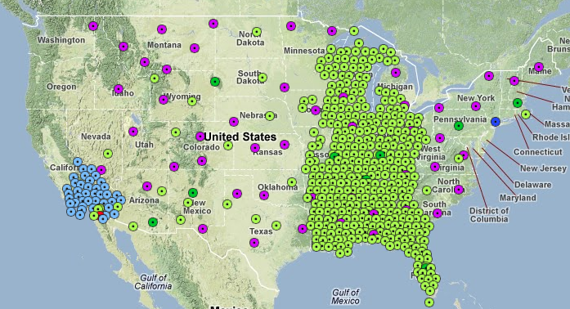
Seismology with Large Continental Arrays
Mike Ritzwoller
CU-Boulder
Department of Physics
Students & Post-Docs:
Yingjie Yang (Macquarie U.)
Morgan Moschetti (USGS)
Fan-Chi Lin (Caltech)
Weisen Shen
Jiayi Xie
Tian Ye
USArray Transportable Array (TA) on Oct 3, 2012
Notes:
Illustrates the length scales of structures that are being resolved.
Slower in the west than the east, of course – but significant variability across the entire region.
Many features recongizable: Snake R. Plain, Rocky Mtns, Columbia Plateau, volcanic rim of the CO Plateau, Mid-Continental Rift, Superior Province, etc.
Talk is about how to construct such images and use them quantitatively to produce a 3D model.

Slide 2
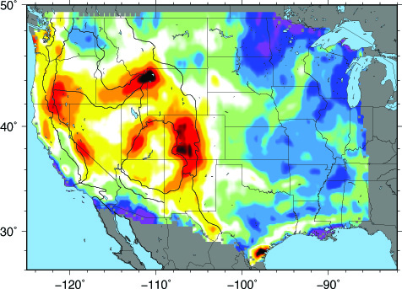
Seismology with Large Continental Arrays
Mike Ritzwoller
CU-Boulder
Department of Physics
Students & Post-Docs:
Yingjie Yang (Macquarie U.)
Morgan Moschetti (USGS)
Fan-Chi Lin (Caltech)
Weisen Shen
Jiayi Xie
Tian Ye
28 s Rayleigh wave phase velocity, ambient noise
Courtesy:
Weisen Shen
km/s
Notes:
Illustrates the length scales of structures that are being resolved.
Slower in the west than the east, of course – but significant variability across the entire region.
Many features recongizable: Snake R. Plain, Rocky Mtns, Columbia Plateau, volcanic rim of the CO Plateau, Mid-Continental Rift, Superior Province, etc.
Talk is about how to construct such images and use them quantitatively to produce a 3D model.

Slide 3
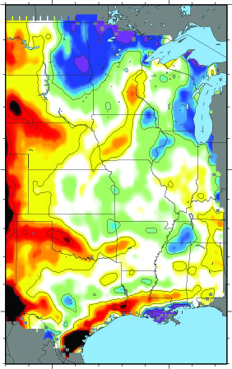
Seismology with Large Continental Arrays
Outline
Background: Frustrations of
“traditional” surface wave tomography.
Methodological enhancements:
Ambient noise tomography
“Flatland” -- observations
in 2D about 3D phenomena.
C. Bayesian Monte Carlo
Some results:
Isotropic structure across the US.
First glimpses of structures in the
Mid-West: Mid-Continental Rift
4. Bonus Material? – Az Anis in W US.
28 s Rayleigh wave
km/s

Slide 4
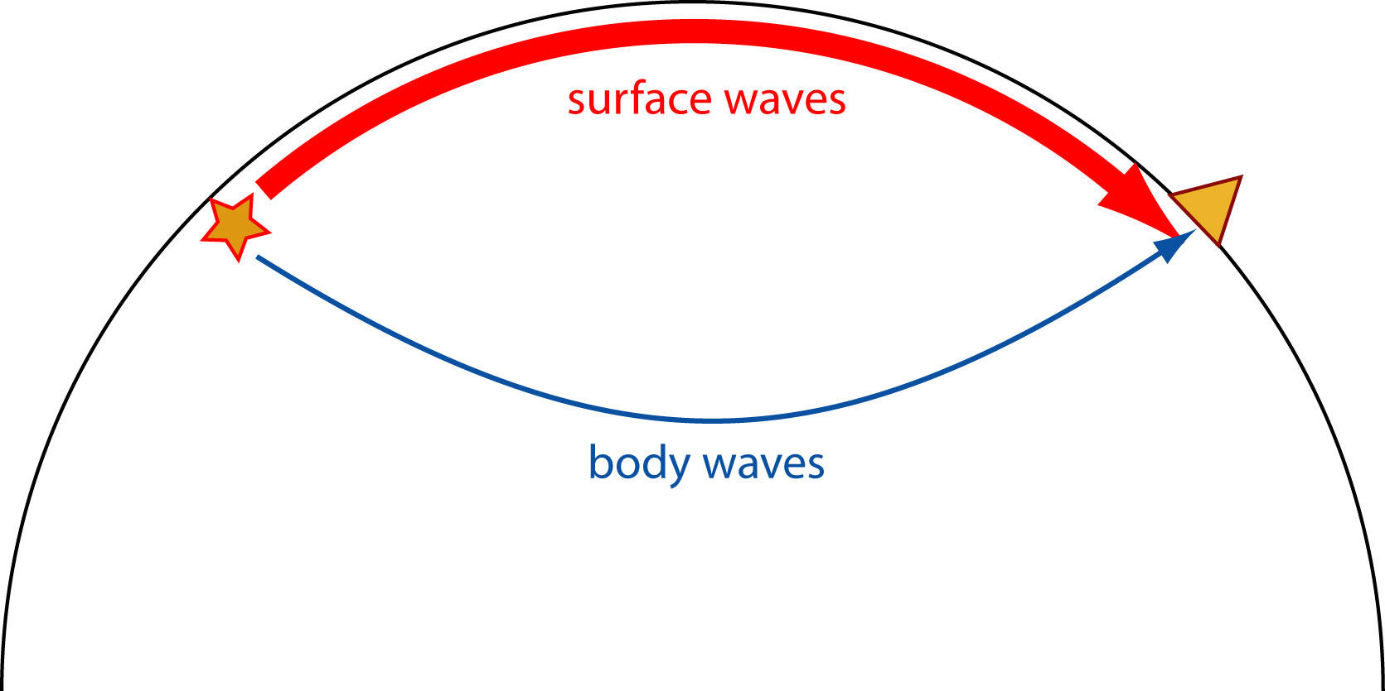
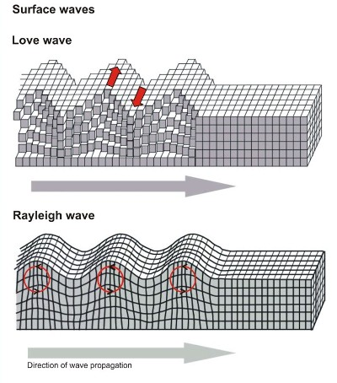
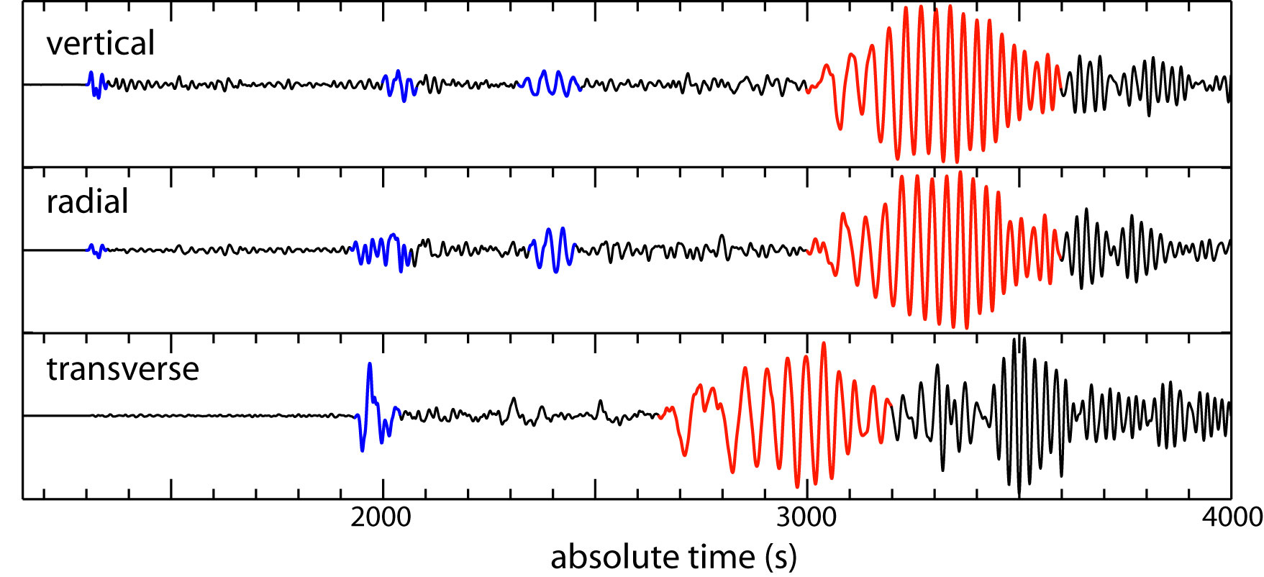
1. Some Background
Surface Waves: Rayleigh and Love
Dispersion
Phase and Group speed.
Body waves sample deep parts of the Earth
Surface waves sample the crust and upper mantle
P
S
P
S
S

Slide 5
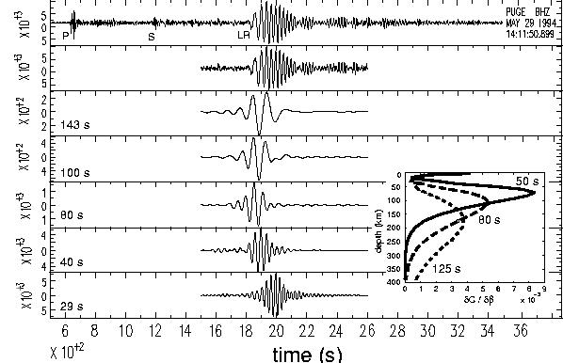
1. Some Background
Surface Waves: Rayleigh and Love
Dispersion
Phase and Group speed.
“Dispersive” characteristic of surface waves provides differential depth sensitivity – what gives depth resolution.
The broader the band of measurement the better.

Slide 6
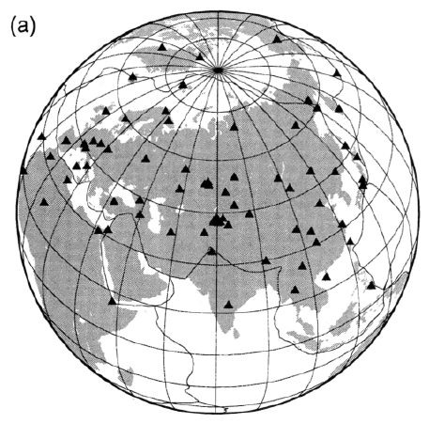
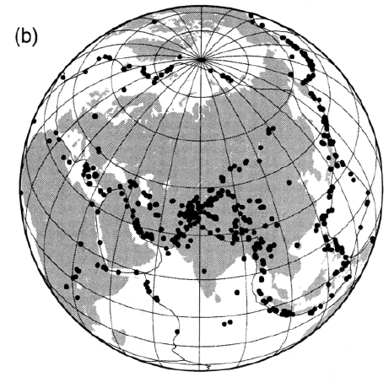
1. Some Background
Example of Traditional Analysis:
Ritzwoller & Levshin, JGR, 1998
stations
“Traditional” Surface Wave Tomography:
1. Distant earthquakes – waves travel a long way.
2. Globally installed stations, with a few national stations regionally.
3. Single station measurements.
4. Only long periods > 20 sec: only weak constraints on the crust.
events

Slide 7
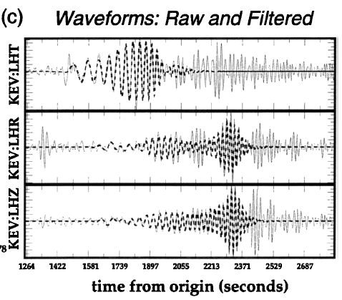
1. Some Background
Example of Traditional Analysis:
Ritzwoller & Levshin, JGR, 1998
stations
events

Slide 8
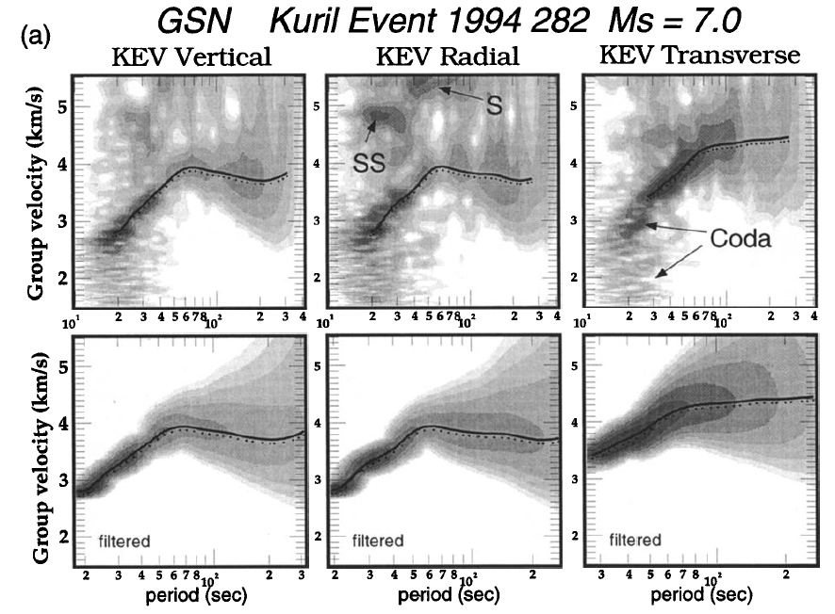
1. Some Background
Example of Traditional Analysis:
Ritzwoller & Levshin, JGR, 1998
stations
events

Slide 9
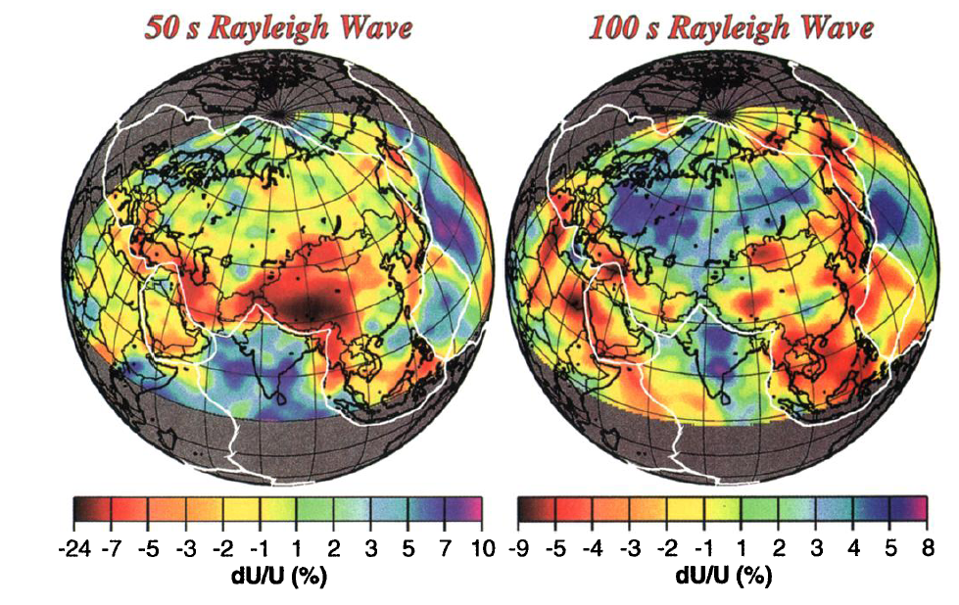
1. Some Background
Example of Traditional Analysis:
Ritzwoller & Levshin, JGR, 1998

Slide 10
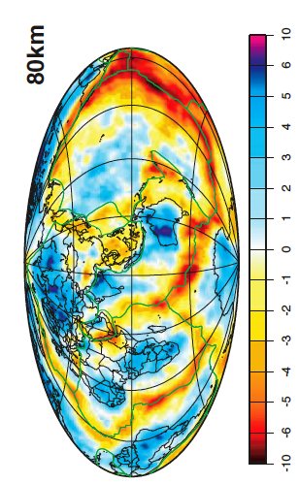
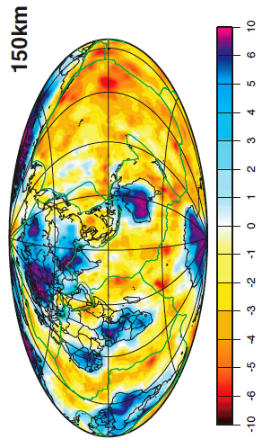
1. Some Background
Example of Traditional Analysis:
Shapiro & Ritzwoller, GJI, 2002
The method has been applied globally:
To image various upper mantle structures:
continental roots
subduction zones
variations in structure along mid-oceanic
ridges
.
.
.
To constrain the thermal structure of the
lithosphere and asthenosphere.
To improve regional event locations.

Slide 11
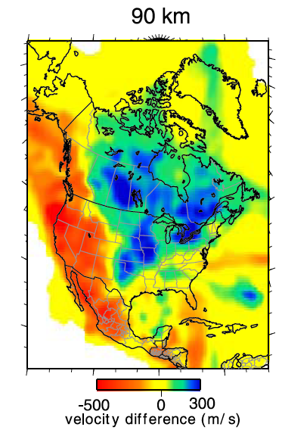
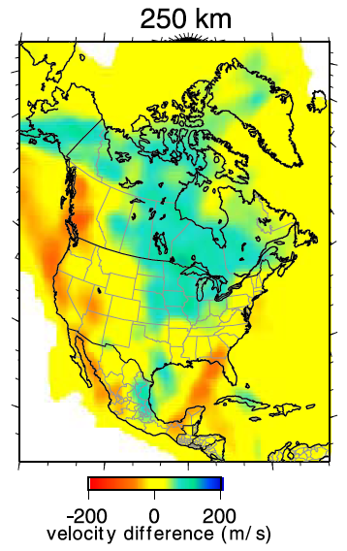
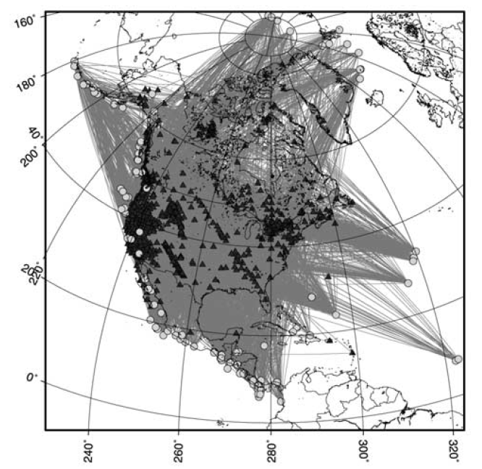
1. Some Background
Example of Traditional Analysis:
Bedle & van der Lee, JGR, 2009
NA07

Slide 12
1. Some Background
Frustrations of “Traditional” surface wave analysis:
Little information about the crust.
Lateral resolution is low:
sensitivity kernels are broad,
earthquakes recur in the same locations.
3. Vertical resolution is also low: Moho.
Tomography relies on ad-hoc choices of damping: anomaly amplitudes are unreliable, anisotropy is notoriously difficult to observe reliably.
Uncertainty analysis is often overlooked.

Slide 13
1. Some Background
Frustrations of “Traditional” surface wave analysis:
Little information about the crust.
Lateral resolution is low:
sensitivity kernels are broad,
earthquakes recur in the same locations.
3. Vertical resolution is also low: Moho.
Tomography relies on ad-hoc choices of damping: anomaly amplitudes are unreliable, anisotropy is notoriously difficult to observe reliably.
Uncertainty analysis is often overlooked.
Easing the frustration:
Ambient noise tomography.
New methods of tomography that exploit dense continental arrays.
3. Joint inversion with receiver functions.
4. New methods of tomography based on “local inversion”.
5. “Local inversions” give uncertainties in dispersion maps, coupled with Bayesian MC methods.

Slide 14
2. Improvements in surface wave methodology
Ambient noise tomography
Idea of the method – demonstrate with a simulation.
Some plots of cross-correlations (empirical Green’s functions).
Derived observable: travel time fields.
B. “Flat Land” – new method to observe 3D structures from 2D arrays
Basic observables.
Localized inversion – eikonal, Helmholtz tomography.
Comparison of AN & EQ results.
C. Bayesian Monte Carlo Inversion

Slide 15
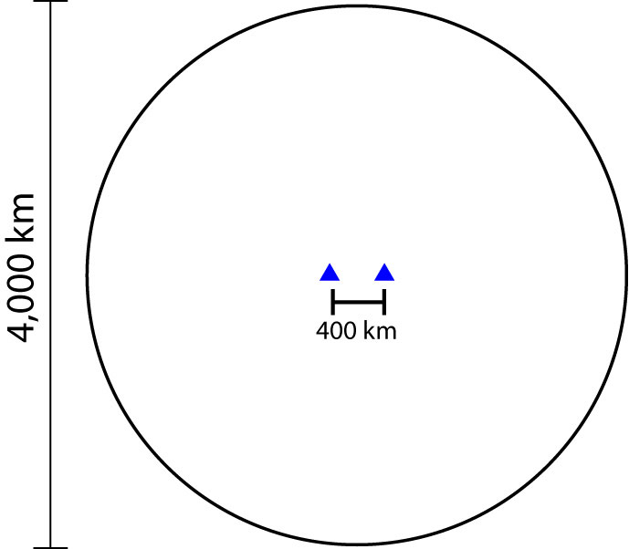
The Idea of the Method
Set-up of the
Simulation:
2 stations

Slide 16
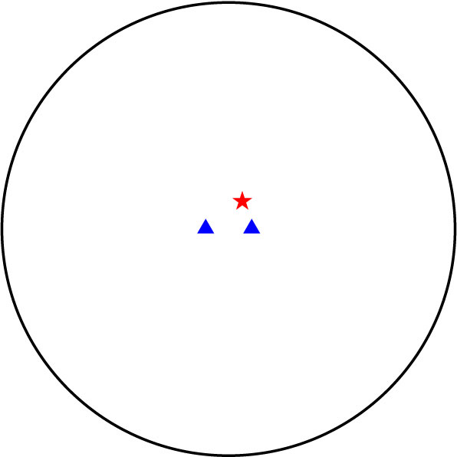
The Idea of the Method
Add a source

Slide 17
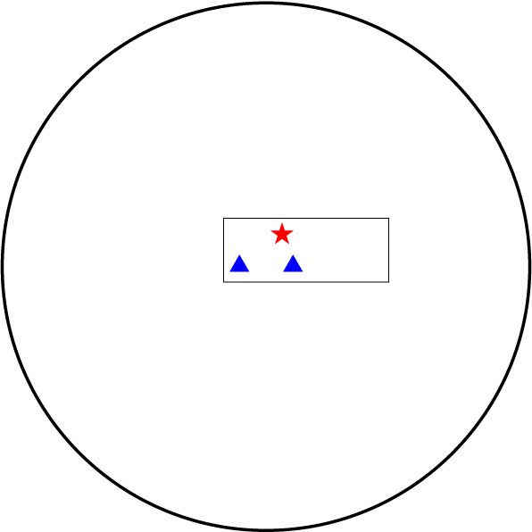
The Idea of the Method
Add a source
Zoom around
receivers

Slide 18
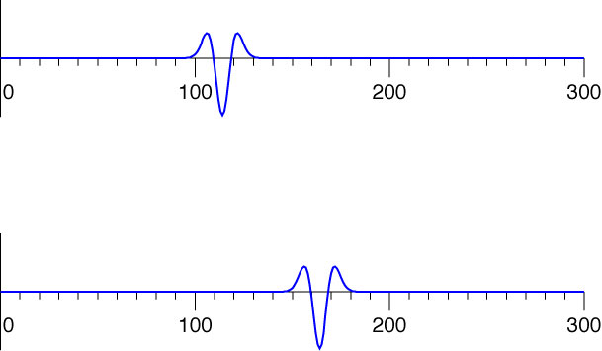
The Idea of the Method
1
2
2
time (sec)
1
time (sec)

Slide 19
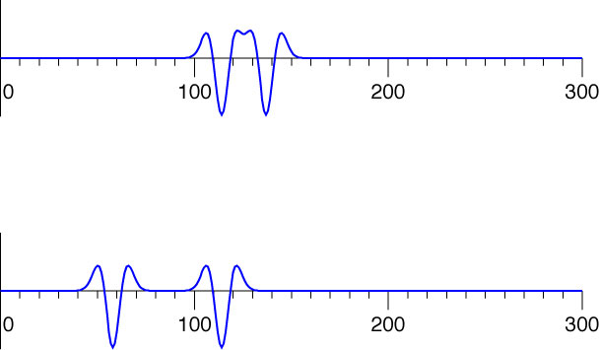
The Idea of the Method
Add another source randomly
1
2
2
time (sec)
1
time (sec)

Slide 20
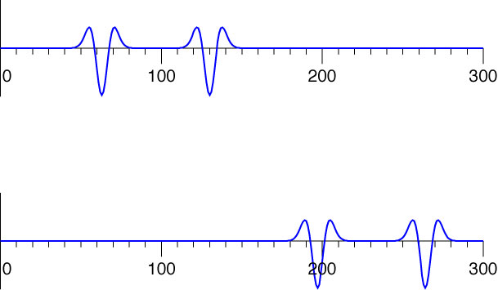
The Idea of the Method
Two sources in line with the stations
1
2
2
time (sec)
1
time (sec)

Slide 21
The Idea of the Method
2
time (sec)
1
2
1
time (sec)
Green function for
propagation between
the stations.
cross-
correlation
lag (sec)

Slide 22
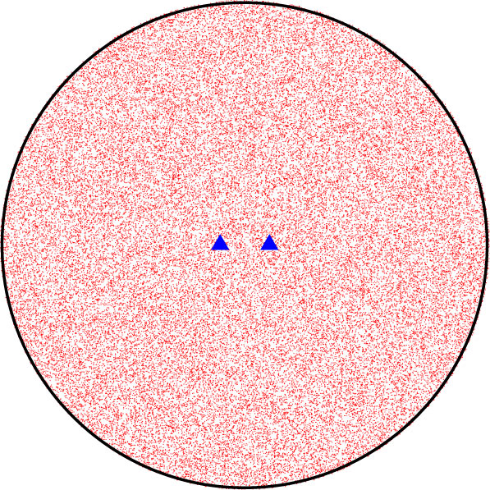
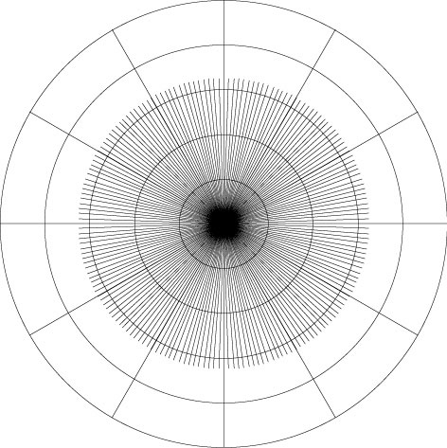
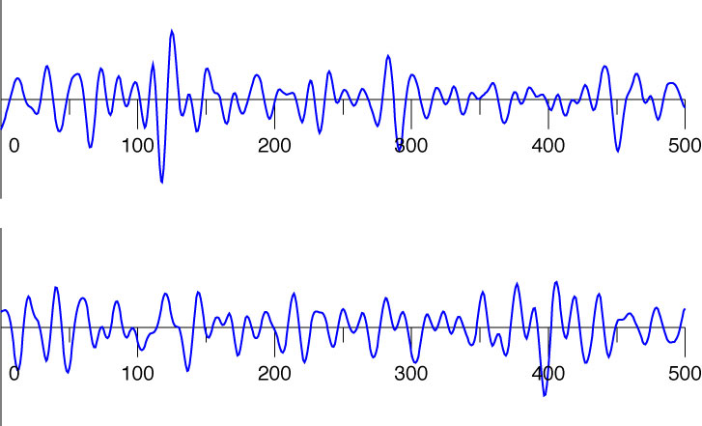
The Idea of the Method
1000s of
sources,
over 30
days
Azimuthally homogeneous
distribution of sources
2
time (sec)
1
time (sec)

Slide 23
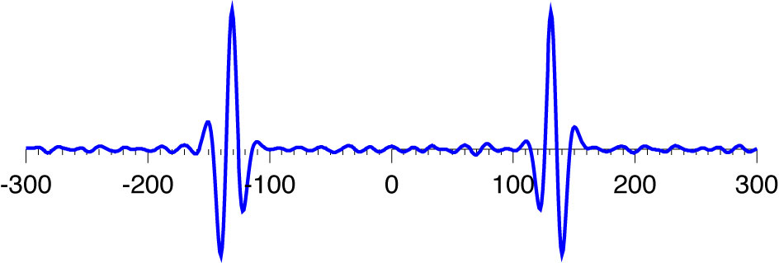
The Idea of the Method
1000s of
sources,
over 30
days
Azimuthally homogeneous
distribution of sources
cross-correlation
lag (sec)

Slide 24
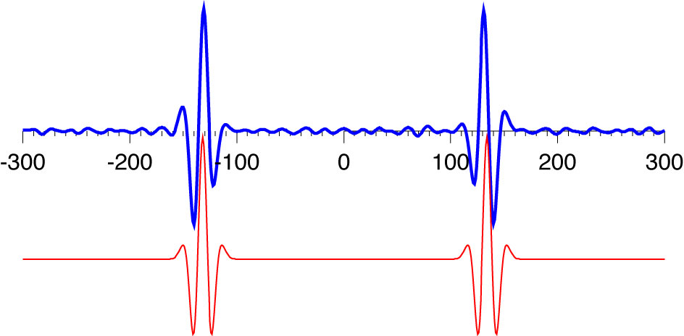
The Idea of the Method
1000s of
sources,
over 30
days
Azimuthally homogeneous
distribution of sources
cross-correlation
lag (sec)
theoretical Green function

Slide 25
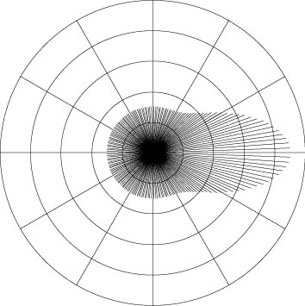
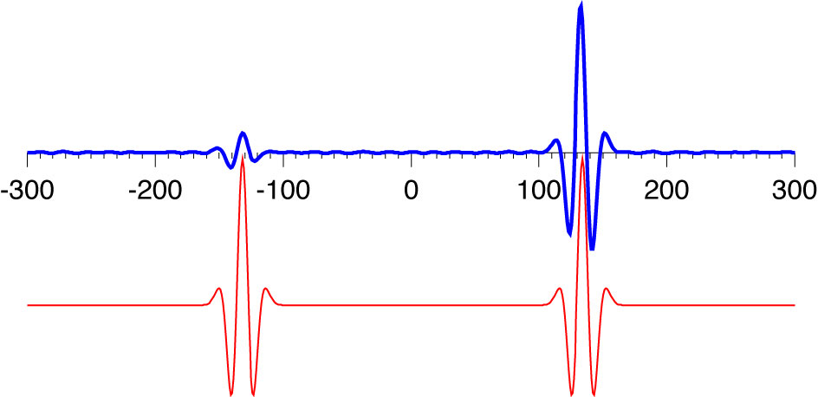
The Idea of the Method
1000s of
sources,
over 30
days
Azimuthally inhomogeneous
distribution of sources
cross-correlation
lag (sec)
lag (sec)
lag (sec)
theoretical Green function

Slide 26
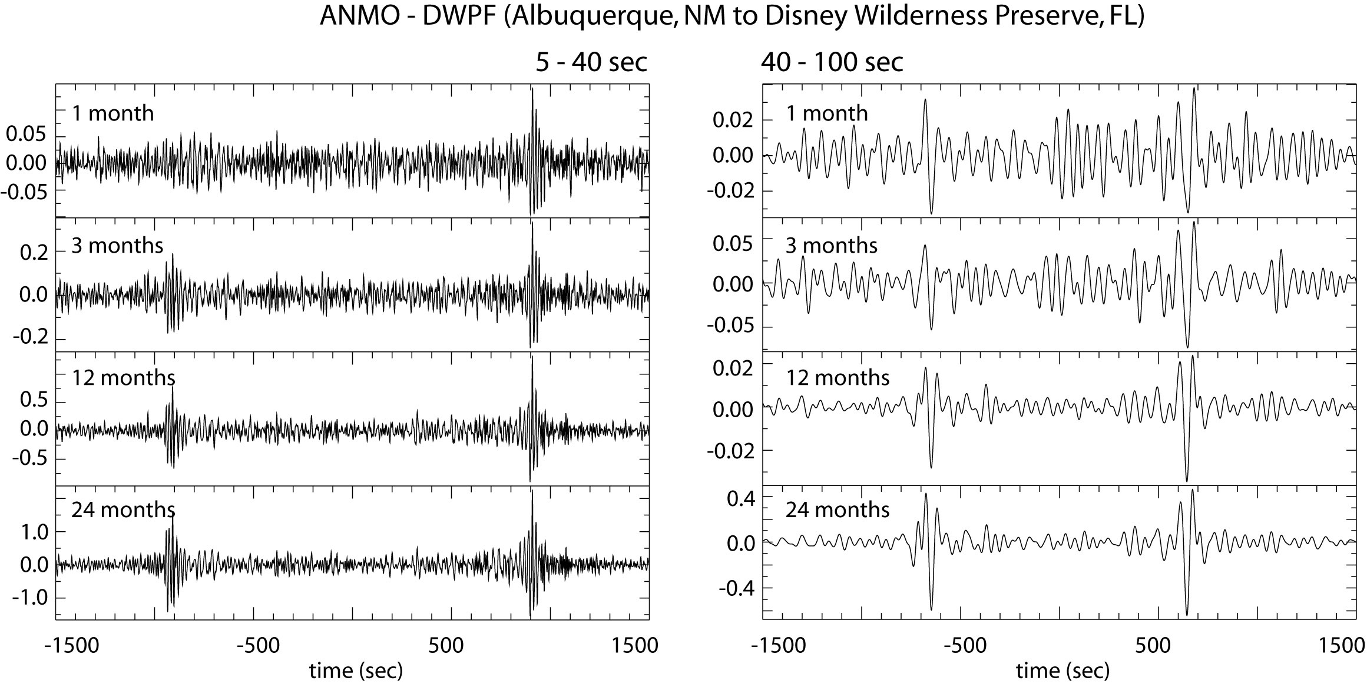
Longer time series are better
Bensen et al. (2007) GJI

Slide 27
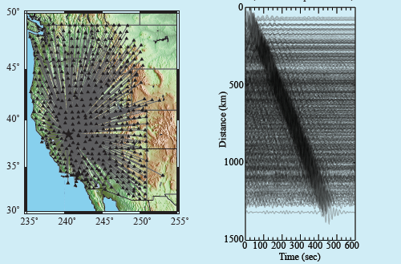
Example record section
15-30s bandpass filtered
R06C
Notes:
Ask Fan-chi about the time duration.

Slide 28
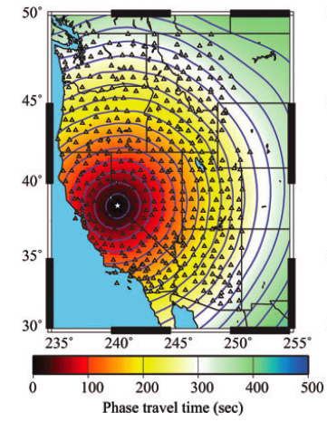
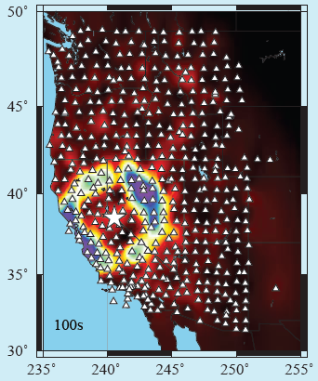
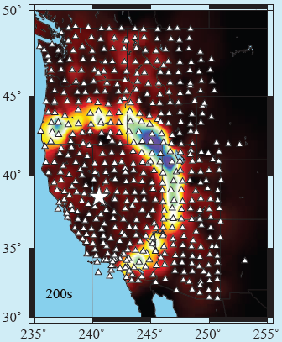
Example travel time field
15-30 bandpass filtered
28 sec Rayleigh wave
R06C
Notes:
Ask Fan-chi about the time duration.

Slide 29
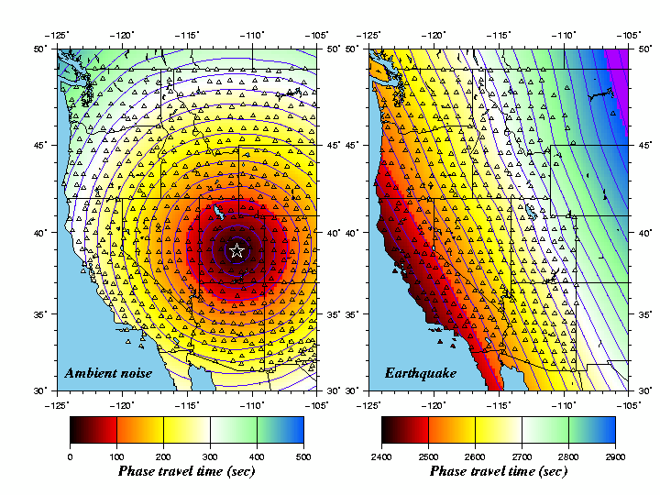
Example travel time field
Fundamental observable in ambient
noise tomography:
Travel time field for each central station at different periods for Rayleigh and Love waves.
Questions:
How do we use this information intelligently?
Can the same methods be applied to earthquake waves?
28 sec
Notes:
Ask Fan-chi about the time duration.

Slide 30
Example travel time fields
Fundamental observable in ambient
noise tomography:
Travel time field for each central station at different periods for Rayleigh and Love waves.
Questions:
How do we use this information intelligently?
Can the same methods be applied to earthquake waves?
28 sec
Earthquake:
Loyalty Is,
(9/28/07)
M=6.5
Notes:
Ask Fan-chi about the time duration.

Slide 31
2. Improvements in surface wave methodology
Ambient noise tomography
Idea of the method – demonstrate with a simulation.
Quick overview of data processing.
Some plots of cross-correlations (empirical Green’s functions).
Derived observable: travel time fields.
B. “Flat Land” – new method to observe 3D structures from 2D arrays
Basic observables.
Localized inversion – eikonal, Helmholtz tomography.
Comparison of AN & EQ results.
C. Bayesian Monte Carlo Inversion

Slide 32
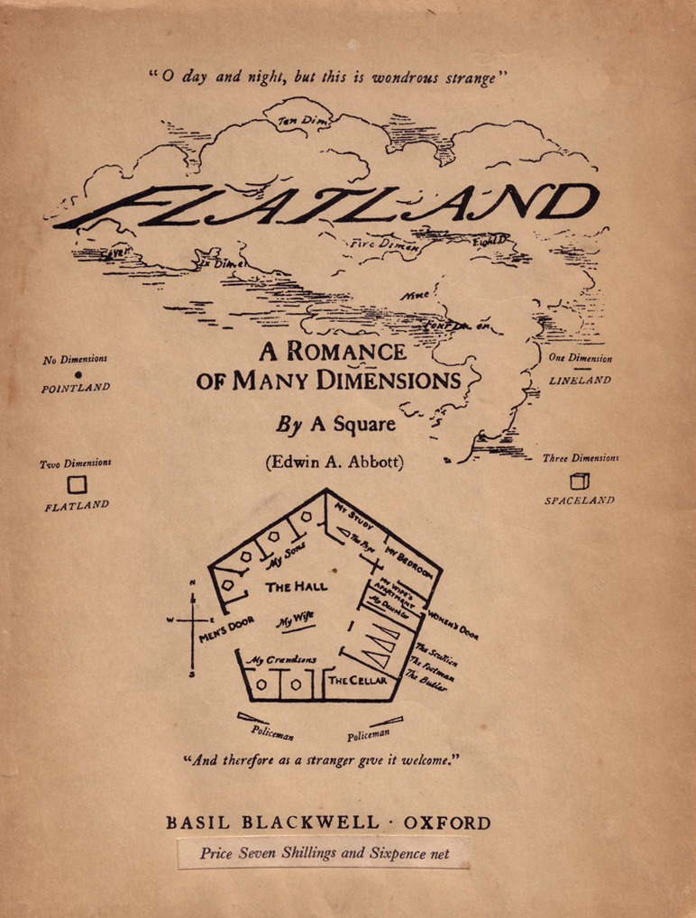
2. Improvements in surface wave methodology
Edwin Abbott (1884)
Social satire.
2D being experiences 3D phenomena:
a square experiences a sphere

Slide 33
“New” Tomographic Methology:
Guiding Principles: looking for methods that
model wave physics which may bias the results,
are straightforward to effect and use,
computationally inexpensive, and
produce estimates of uncertainties – so results can be combined with other kinds of data and used by other researchers.
Differences between ambient noise and earthquake imaging:
ambient noise (6-40 sec) is in a different but overlapping frequency band from
earthquake waves (25-80 sec),
ambient noise amplitude field is a complicated story,
earthquake waves require “finite frequency” corrections (performed
through amplitudes) because they’re longer period .
Gloss over the details and complications: but “the devil is in the details”.

Slide 34
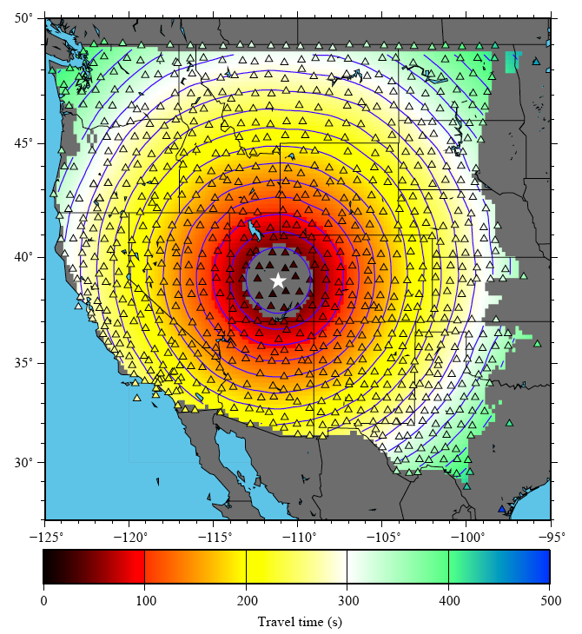
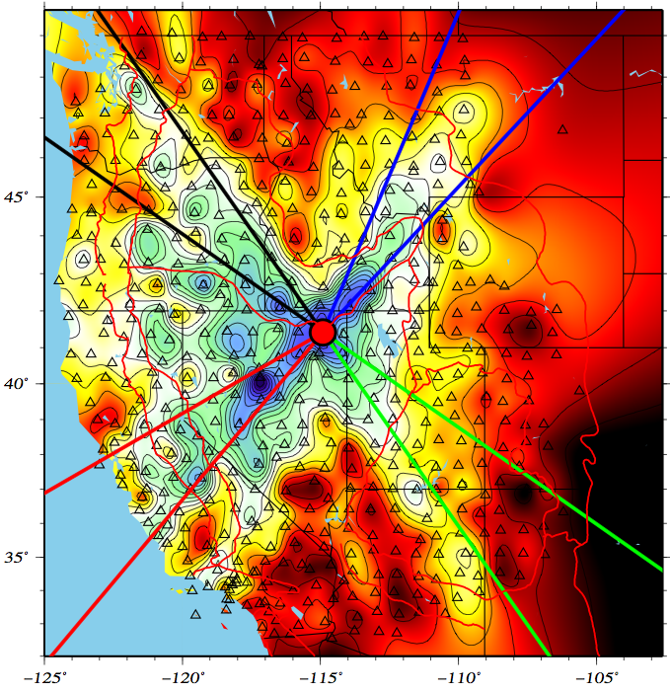
Basic Observables From Ambient Noise
Travel Time Field τ(r)
Amplitude Field A(r)
Currently
Unknown
24 s
Q16A
16 s
M12A
24 s
Q16A
symmetric
Tsai, V. C. (2011), Understanding the amplitudes of noise correlation measurements, J. Geophys. Res., 116, B09311, doi:10.1029/2011JB008483.
travel time (s) normalized amplitude

Slide 35
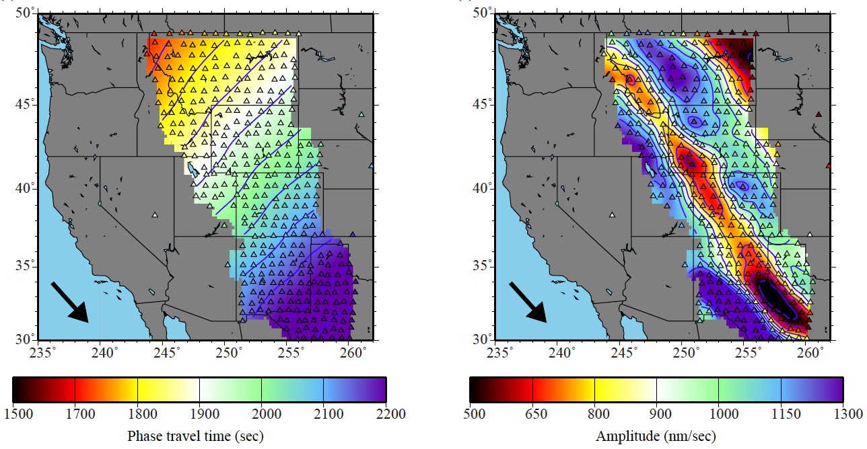
Basic Observables From An Earthquake
Travel Time Field τ(r)
Amplitude Field A(r)
60 s
Kuril Is Eq
7 Apr 2009
Ms = 6.8
Lin, F.C. and M.H. Ritzwoller, Helmholtz surface wave tomography for isotropic and azimuthally anisotropic structure, Geophys. J. Int., 186, 1104-1120, 2011.

Slide 36
“New” Methology:
Guided by the 2-D wave equation locally without inversion.
Normally:
Approximations are made.
Solutions for measurable quantities are in the form of integrals.
Inverse problem, undoes the effect of the solution – deintegrates.
Basis functions are global quantities.
Approach here:
Make measurements of the wavefield.
Interpret them locally guided by the wave equation.
There is no “solution” and no “deintegration”.
There is no “inversion”.
e.g. Wielandt, Friederich, Pollitz, Langston, Fan-Chi Lin

Slide 37
“New” Methology:
Guided by the 2-D wave equation locally without inversion.
Two step “inference”:
Step 1: Phase velocity maps produced by Eikonal or Helmholtz tomography, with uncertainties.
Ambient noise (8-40s) Earthquakes (25-80s)
Step 2: Monte Carlo inversion
Ensemble of models gives uncertainties subject to prior information.

Slide 38
2-D Wave Equation for Surface Wave Potential
α(r) = anelastic attenuation (inferred)
c(r) = phase speed (inferred)

Slide 39
2-D Wave Equation for Surface Wave Potential
α(r) = anelastic attenuation (inferred)
c(r) = phase speed (inferred)
Tanimoto, 1990
Tromp & Dahlen, 1992, 1993
A(r) = amplitude (observed)
τ(r) = travel time (observed)
β(r) = local amplification, a 3-D effect (inferred)

Slide 40
2-D Wave Equation for Surface Wave Potential
α(r) = anelastic attenuation (inferred)
c(r) = phase speed (inferred)
Tanimoto, 1990
Tromp & Dahlen, 1992, 1993
A(r) = amplitude (observed)
τ(r) = travel time (observed)
β(r) = local amplification, a 3-D effect (inferred)
Real Part -- Helmholtz Equation:
Set β = 1 for simplicity.
Shearer, Intro to Seismology, App. 3

Slide 41
2-D Wave Equation for Surface Wave Potential
α(r) = anelastic attenuation (inferred)
c(r) = phase speed (inferred)
Tanimoto, 1990
Tromp & Dahlen, 1992, 1993
A(r) = amplitude (observed)
τ(r) = travel time (observed)
β(r) = local amplification, a 3-D effect (inferred)
Real Part -- Helmholtz Equation: Imaginary Part:
Set β = 1 for simplicity.
Lin et al., GJI, 2009. (Eikonal tomography)
Lin et al., GJI, 2011. (Helmholtz tomography)
Lin et al., JGR, 2012. (Amplification)
Lin et al., GRL, 2012. (Ellipticity)
Shearer, Intro to Seismology, App. 3

Slide 42
Rewrite the Real-Part Equation First:
Helmholtz equation
slowness-squared
(inferred quantity)
oberved quantity,
geometrical ray
theory
observed quantity, “finite frequency”
correction
Local measurements of and determine
slowness-squared locally.

Slide 43
Rewrite the Real-Part Equation First:
Helmholtz equation
slowness-squared
(inferred quantity)
oberved quantity,
geometrical ray
theory
observed quantity, “finite frequency”
correction
At higher frequencies, the second term on the RHS can be dropped
approximately, yielding geometric ray theory:
Eikonal equation

Slide 44
Localized Tomography: Eikonal Tomography
24 sec Rayleigh wave
eikonal equation
Valid: < 50 sec period
Eikonal eqn can be used for ambient
noise.
But, not for earthquakes above ~50s where there is amplitude information.
Lin, F.-C., M.H. Ritzwoller, and R. Snieder, Eikonal Tomography: Surface wave tomography by phase-front tracking across a regional broad-band seismic array, Geophys. J. Int., 177(3), 1091-1110, 2009.

Slide 45
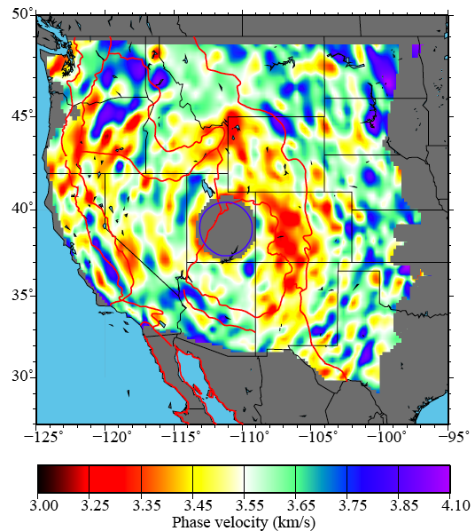
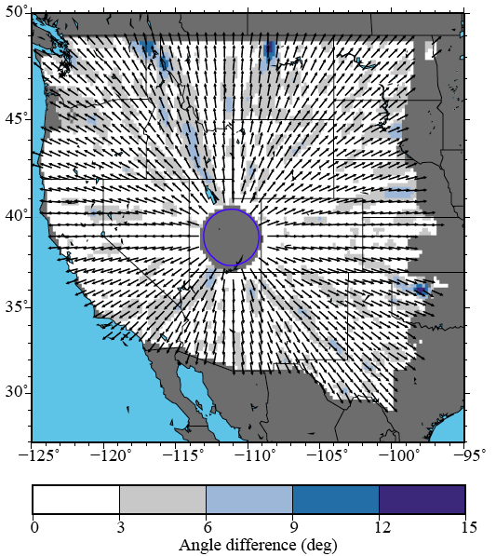
Localized Tomography: Eikonal Tomography
24 sec Rayleigh wave
phase speed
direction of propagation

Slide 46
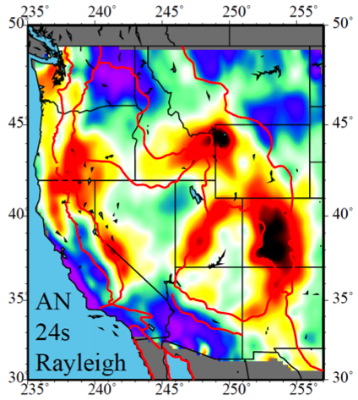
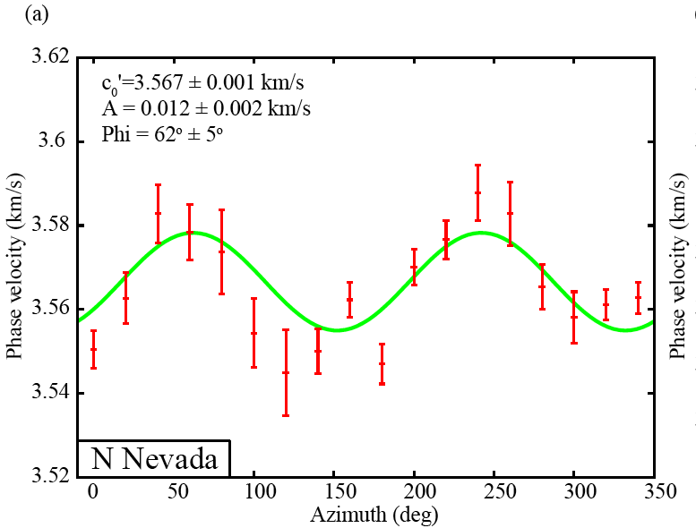
Localized Tomography: Eikonal Tomography
24 sec Rayleigh wave
phase speed

Slide 47
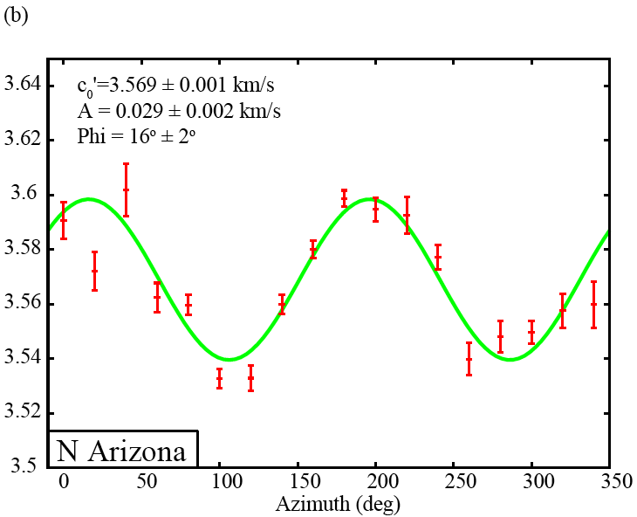
Localized Tomography: Eikonal Tomography
24 sec Rayleigh wave
phase speed

Slide 48
Travel Time Field τ(r)
Amplitude Field A(r)
60 s
Kuril Is Eq
7 Apr 2009
Ms = 6.8

Slide 49
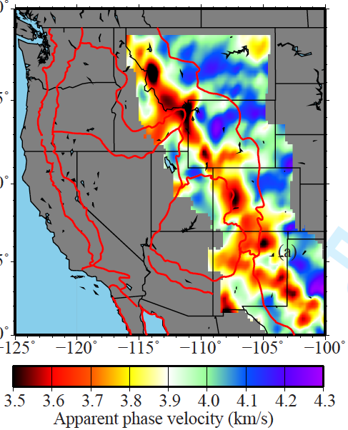
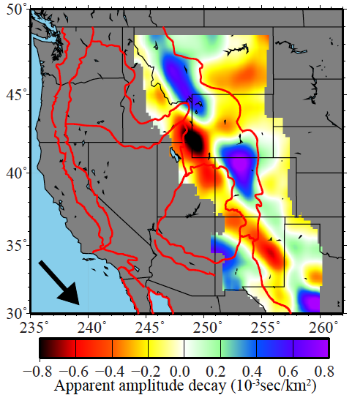
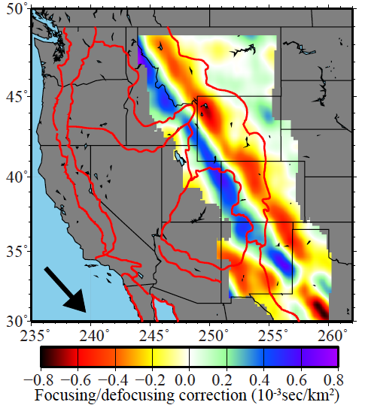
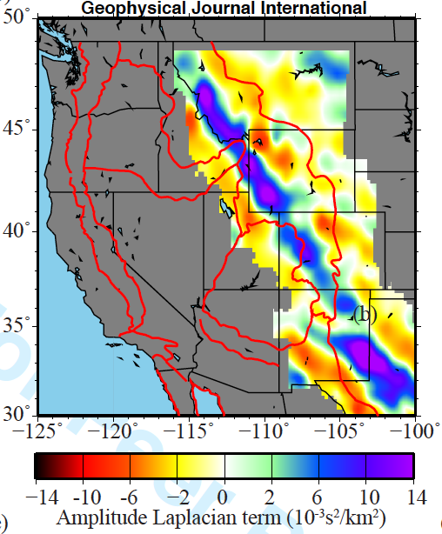
60 s
Kuril Is Eq
7 Apr 2009
Ms = 6.8
τ(r)
A(r)
τ(r)
A(r)
τ(r)
A(r)

Slide 50
60 s
Kuril Is Eq
7 Apr 2009
Ms = 6.8
τ(r)
A(r)
|
-1
|
τ(r)
A(r) •
τ(r)
apparent phase
speed
apparent amplitude decay
τ(r)
A(r)

Slide 51
60 s
Kuril Is Eq
7 Apr 2009
Ms = 6.8
τ(r)
A(r)
|
-1
|
τ(r)
A(r) •
τ(r)
apparent phase
speed
apparent amplitude decay
τ(r)
A(r)/ω²A(r)
amplitude decay
correction
phase slowness correction
squared

Slide 52
60 s
Kuril Is Eq
7 Apr 2009
Ms = 6.8
τ(r)
A(r)
|
-1
|
τ(r)
A(r) •
τ(r)
apparent phase
speed
apparent amplitude decay
τ(r)
A(r)/ω²A(r)
amplitude decay
correction
phase slowness correction
squared

Slide 53
60 s
Kuril Is Eq
7 Apr 2009
Ms = 6.8
τ(r)
A(r)
|
-1
|
τ(r)
A(r) •
τ(r)
apparent phase
speed
apparent amplitude decay
τ(r)
A(r)/ω²A(r)
amplitude decay
correction
phase slowness correction
squared

Slide 54
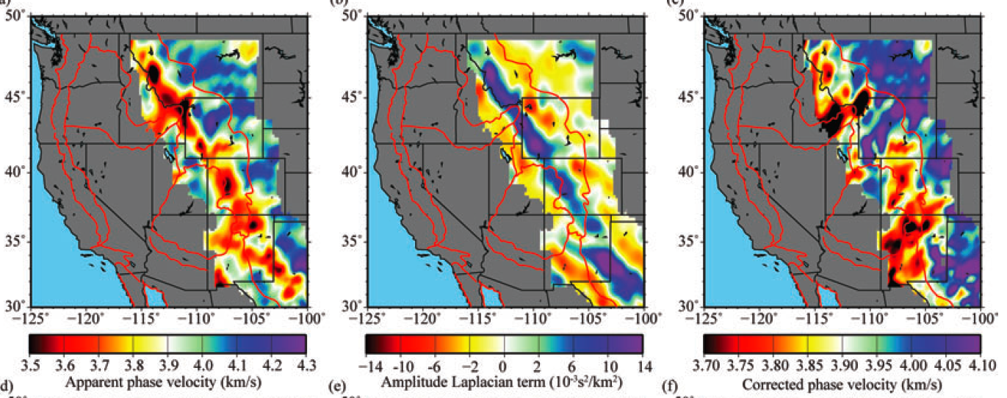
60 s Rayleigh wave
Kuril Is Eq, 7 Apr 2009, Ms = 6.8
-
=
Eikonal term:
geometrical ray theory
Finite frequency correction:
wavefront healing
focusing/defocusing
backscattering
Corrected phase
speed

Slide 56
Effect of the “Finite-Frequency” Correction:
Isotropic structure: increases amplitudes & sharpen contrasts.

Slide 58
Effect of the “Finite-Frequency” Correction:
Isotropic structure: increases amplitudes & sharpen contrasts.
Anisotropic structure: reduces amplitudes & improves consistency across
periods.

Slide 59
Comparison of Ambient Noise & Earthquake Tomography
Ambient Noise
28 sec Rayleigh wave
Earthquakes
Eikonal
tomography
Helmholtz
tomography

Slide 60
Comparison of Ambient Noise & Earthquake Tomography
Ambient Noise
28 sec Rayleigh wave
Earthquakes
Eikonal
tomography
Helmholtz
tomography
Differences:
Some features differ in amplitude.
Edge effects in ambient noise map.
Differences typically lie within
uncertainties except near the edge
of the map.

Slide 61
Comparison of Ambient Noise & Earthquake Tomography
Ambient Noise
Earthquakes

Slide 62
Comparison of Ambient Noise & Earthquake Tomography
Ambient Noise
Earthquakes

Slide 63
Comparison of Ambient Noise & Earthquake Tomography
Ambient Noise
Earthquakes

Slide 64
“New” Methology:
Limitations:
monochromatic (instantaneous frequency) – different from what is measured.
a certain level of structural smoothness is assumed.
3-D wavefield effects are largely missing.
e.g., coupling to overtones, Rayleigh-Love coupling
application of differential operators to measured fields is noisy.
Strengths:
computationally fast.
simple to effect – travel time and amplitude fields are needed, with gradient
and Laplacian.
there is no actual inversion (no ad-hoc matrix damping, regularization, etc.).
it’s totally local – no lateral basis functions (e.g., spherical harmonics).
includes “finite frequency” effects and off great-circle propagation.
naturally generates uncertainty estimates.

Slide 65
3A. Some Results:
Joint Inversion of Receiver Functions and Rayleigh Wave Dispersion from Ambient Noise and Earthquake Data Using More Than 1000 TA Stations
Shen et al. (2012), GJI, JGR
3B. Some Results:
First Glimpses of the Mid-Continental Rift in the Crust and Uppermost Mantle.
Work in progress – Weisen Shen.

Slide 66
2. Improvements in surface wave methodology
Ambient noise tomography
Idea of the method – demonstrate with a simulation.
Quick overview of data processing.
Some plots of cross-correlations (empirical Green’s functions).
Derived observable: travel time fields.
B. “Flat Land” – new method to observe 3D structures from 2D arrays
Basic observables.
Localized inversion – eikonal, Helmholtz tomography.
Comparison of AN & EQ results.
C. Bayesian Monte Carlo Inversion

Slide 67
Receiver function analysis
Shen et al. (2012) GJI in press

Slide 68
Receiver function analysis: Harmonic Stripping

Slide 71
Example Result

Slide 72
Example Result

Slide 74
Example Result
A

Slide 75
Example Result
A

Slide 76
3A. Some Results:
Joint Inversion of Receiver Functions and Rayleigh Wave Dispersion from Ambient Noise and Earthquake Data Using More Than 1000 TA Stations
Shen et al. (2012), GJI, JGR
3B. Some Results:
First Glimpses of the Mid-Continental Rift in the Crust and Uppermost Mantle.
Work in progress – Weisen Shen.

Slide 77
4. Mid-Continental Rift
Superior Province Rift EarthScope Experiment (SPREE)
Stein et al. (2011), GSA Today

Slide 78
4. Mid-Continental Rift
Work by Weisen Shen

Slide 79
4. Mid-Continental Rift
Work by Weisen Shen

Slide 80
4. Mid-Continental Rift
Work by Weisen Shen

Slide 81
4. Mid-Continental Rift
Receiver Functions along the Rift
Work by Weisen Shen

Slide 82
4. Mid-Continental Rift
Work by Weisen Shen

Slide 83
4. Mid-Continental Rift
Work by Weisen Shen

Slide 84
4. Mid-Continental Rift
Work by Weisen Shen

Slide 85
4. Mid-Continental Rift
Work by Weisen Shen

Slide 86
4. Mid-Continental Rift
?
Work by Weisen Shen

Slide 87
4. Mid-Continental Rift
Work by Weisen Shen

Slide 89
Conclusions:
The TA is an incredibly powerful tool for surface wave tomography.
It inspired the development both of ambient noise tomography and the new methods of surface wave inference described today.
We’re still learning how to use it intelligently.
In terms of future deployments:
1. A 2-yr, 75-km spacing is very good for surface waves.
2. A tighter station spacing would help:
with the computation of spatial differential operators (e.g., gradient, Laplacian) and
with computation of receiver functions.

Slide 90
4. Bonus Material:
Inversion of Rayleigh Wave Dispersion from Ambient Noise and Earthquake Data to Infer Azimuthal Anisotropy in the Crust and Uppermost Mantle
Inclusion of SKS splitting to Infer Azimuthal Anisotropy in the Asthenosphere
Lin et al. (2011), Nature Geoscience

Slide 91
Observations of Azimuthal Anisotropy at Different Periods

Slide 92
12 s
26 s
38 s
Lin, F.C., M.H. Ritzwoller, Y. Yang, M.P. Moschetti, and M.J. Fouch, Complex and variable crustal and uppermost mantle seismic anisotropy in the western United States , Nature Geoscience, Vol 4, Issue 1, 55-61, Jan 2011.

Slide 93
12 s
26 s
38 s
.
N. Nevada
.
.
.
Lin, F.C., M.H. Ritzwoller, Y. Yang, M.P. Moschetti, and M.J. Fouch, Complex and variable crustal and uppermost mantle seismic anisotropy in the western United States , Nature Geoscience, Vol 4, Issue 1, 55-61, Jan 2011.

Slide 94
Crustal Anisotropy:
Coheres with geological provinces:
N - S Basin & Range
NW – SE CA Central Valley
E – W Cascadia Forearc
NE – SW Colorado Plateau
E – W High Lava Plains
Weak Snake River Plain
Lin, F.C., M.H. Ritzwoller, Y. Yang, M.P. Moschetti, and M.J. Fouch, Complex and variable crustal and uppermost mantle seismic anisotropy in the western United States , Nature Geoscience, Vol 4, Issue 1, 55-61, Jan 2011.

Slide 95
Mantle Anisotropy:
Less coherent with geological provinces.
Coheres with low velocities (warm temperatures) in the uppermost mantle.
Reflects changes in ambient stress field:
e.g., Mendocino Triple Junction
Lin, F.C., M.H. Ritzwoller, Y. Yang, M.P. Moschetti, and M.J. Fouch, Complex and variable crustal and uppermost mantle seismic anisotropy in the western United States , Nature Geoscience, Vol 4, Issue 1, 55-61, Jan 2011.

Slide 96
After adding SKS splitting
Lin, F.C., M.H. Ritzwoller, Y. Yang, M.P. Moschetti, and M.J. Fouch, Complex and variable crustal and uppermost mantle seismic anisotropy in the western United States , Nature Geoscience, Vol 4, Issue 1, 55-61, Jan 2011.

Slide 98
Example record section
15-30s bandpass filtered
R06C
Notes:
Ask Fan-chi about the time duration.

Slide 99
Example record section
15-30 bandpass filtered
R06C
Notes:
Ask Fan-chi about the time duration.

Slide 100
Ambient noise data processing: data aren’t perfect
Year long cross-correlations between two TA stations (116A and R06C)
Lin et al. (2008) GJI

Slide 101
Travel Time Field τ(r)
Amplitude Field A(r)
24 s
Q16A
16 s
M12A
24 s
Q16A
symmetric
500 2000 3500 5000 6500 8000 9500 12000
travel time (s) normalized amplitude

Slide 102
Amplitude Field A(r)
24 s
Q16A
16 s
M12A
24 s
Q16A
symmetric
500 2000 3500 5000 6500 8000 9500 12000
travel time (s) normalized amplitude

Slide 103
Amplitude Field A(r)
16 s
M12A
outgoing
500 2000 3500 5000 6500 8000 9500 12000
travel time (s) normalized amplitude
Tsai, V. C. (2011), Understanding the amplitudes of noise correlation measurements, J. Geophys. Res., 116, B09311, doi:10.1029/2011JB008483.

Slide 104
Amplitude Field A(r)
Which amplitude field should we use?
Fundamental problems/questions:
1. Data processing procedures make it difficult to compare amplitudes at different stations.
2. Stations operate at different times, that have different ambient noise conditions.
3. Do the measured amplitudes reflect propagation?
16 s
M12A
outgoing
500 2000 3500 5000 6500 8000 9500 12000
travel time (s) normalized amplitude
Tsai, V. C. (2011), Understanding the amplitudes of noise correlation measurements, J. Geophys. Res., 116, B09311, doi:10.1029/2011JB008483.

Slide 107
Mantle Anisotropy:
Less coherent with geological provinces.
Coheres with low velocities (warm temperatures) in the uppermost mantle.
Reflects changes in ambient stress field:
e.g., Mendocino Triple Junction
Crustal and uppermost mantle anisotropy
differ in geometry:
Constrains strain partitioning between
the crust and uppermost mantle.
Lin, F.C., M.H. Ritzwoller, Y. Yang, M.P. Moschetti, and M.J. Fouch, Complex and variable crustal and uppermost mantle seismic anisotropy in the western United States , Nature Geoscience, Vol 4, Issue 1, 55-61, Jan 2011.

Slide 108
1. Some Background
Example of Traditional Analysis:
Shapiro and Ritzwoller, 2002
Dispersion maps combined locally
Monte-Carlo sampling of model space to find an ensemble of acceptable models

Slide 109
Rewrite the Imaginary-Part Equation:
focusing/defocusing correction
(observed quantity)
corrected amplitude decay
(inferred quantity)
apparent amplitude decay
(observed quantity)

Slide 110
Rewrite the Imaginary-Part Equation:
focusing/defocusing correction
(observed quantity)
anelastic attenuation
(inferred quantity)
apparent amplitude decay
(observed quantity)
amplification
(inferred quantity)
To separate the anelastic and amplification terms:
(1) anelastic term does not vary with azimuth, amplification does,
(2) amplification term is much larger

Slide 111
-
~

Slide 112
-
~

Slide 113
-
~

Slide 114
-
~
corrected amplitude decay
apparent amplitude decay
1. 180° azimuthal symmetry – due to amplification term β.
2. d.c. shift due to anelastic attenuation α.

Slide 115
amplification 30 sec
amplification 60 sec

Slide 116
amplification 30 sec
amplification 60 sec
Amplification β can be predicted from a 3-D
(Vs, ρ) model:
Depends in part on density.

Slide 117
amplification 30 sec
amplification 60 sec

Slide 119
Ambient noise:
Travel time τ(r)
Earthquake:
Travel time τ(r)
Earthquake:
Amplitude τ(r)
Outline:
show observations of surface waves from ambient noise and earthquakes across the TA,
overview of the “new” methology,
application of the method to both ambient noise and earthquake data,
present some results (isotropic structure, azimuthal anisotropy,
local amplification)

Slide 120
Example travel time fields
Fundamental observable in ambient
noise tomography:
Travel time field for each central station at different periods for Rayleigh and Love waves.
Questions:
How do we use this information intelligently?
Can the same methods be applied to earthquake waves?
24s
24s
12s
12s
Notes:
Ask Fan-chi about the time duration.

Slide 121
Seismology with Large Continental Arrays
Themes
Importance of improving the modeling
of wave physics to advance the field.
2. Importance of estimating uncertainties
in all measured and derived quantities.
28 s Rayleigh wave
km/s

Slide 122
1. Some Background
Example of Traditional Analysis:
Ritzwoller & Levshin, JGR, 1998
stations
events

Slide 123
Ambient noise data processing
Processing Steps:
Remove instrument response, de-mean, de-trend, bandpass filter, time-domain normalization, spectral whitening
Cross-correlation: 1 day at a time.
Stack over many days.
Waveform selection for tomography
Station 109C
Station Y12C
16.3 Month Stack
time (s)

Slide 124
Example Result
A
B
A B
Yellow-
stone
A
Shen, W., M.H. Ritzwoller, V. Schulte-Pelkum, F.-C. Lin, Joint inversion of surface wave dispersion and receiver functions: A Bayesian Monte-Carlo approach, Geophys. J. Int., submitted.

Slide 125
JGR, 2002
JGR, 2003
Nature, 2002
Geology, 2005

Slide 126
Seismology with Large Continental Arrays
Mike Ritzwoller
CU-Boulder
Department of Physics
Vs at 100 km, Nettles & Dziewonski (2008)
TA overplotted with white dots
Courtesy of:
Vadim Levin
km/s
Notes:
Illustrates the length scales of structures that are being resolved.
Slower in the west than the east, of course – but significant variability across the entire region.
Many features recongizable: Snake R. Plain, Rocky Mtns, Columbia Plateau, volcanic rim of the CO Plateau, Mid-Continental Rift, Superior Province, etc.
Talk is about how to construct such images and use them quantitatively to produce a 3D model.

